Slide 1
Progress Report
Keerat Singh
Notes:
Add graphics

Slide 3
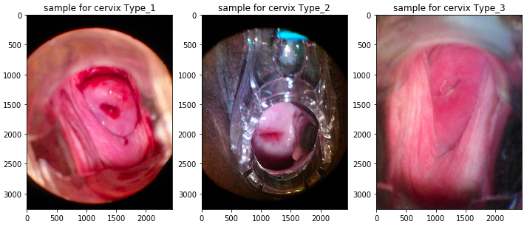

Slide 4
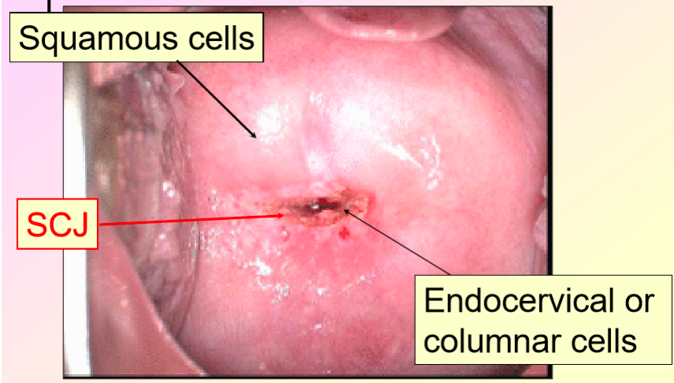
Data

Slide 5
Projected Plan
Download data
Clean and analyze data
Histogram
equalizations
Probablistic neural network
Self Organizing Map
PCA
Notes:
Add graphics Then elaborate more on each thing

Slide 6
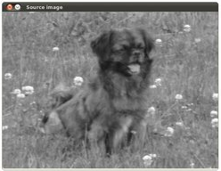
Histogram equalizations

Slide 7
Principal component analysis (PCA)
Entered into PCA
Returned by PCA

Slide 8
Probablisitic neural network

Slide 9
Self-organizing map

Slide 10
First check progress
Finished Kaggle Introduction to Machine Learning: Titanic Disaster
Downloaded all images and separated the training set based on type
Started looking into possible techniques

Slide 11
Current check progress
Learning how to use OpenCV
Cleaned and analyzed data
Started implementing histogram equalizations
Talked with Dr. Oguz on using histogram equalizations, PCA, and self-organizing maps

Slide 12
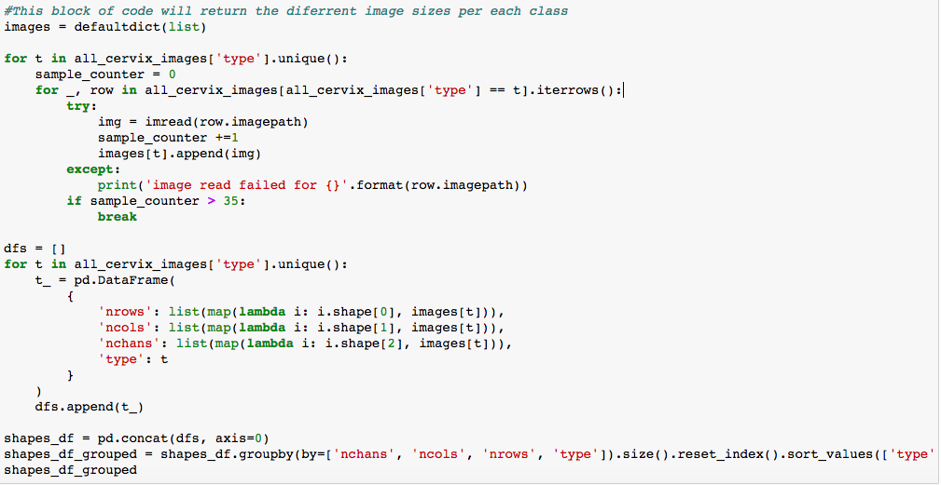
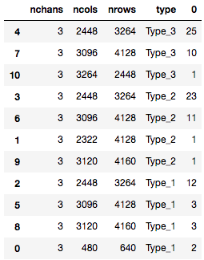

Slide 13
Next steps
Finish implementing histogram equalizations
Start PCA
Implement self-organizing maps and probabilistic neural network using OpenCV

Slide 14
References
Chen, E., Chung, P., Chen, C., Tsai, H., & Chang, C. (1998). An automatic diagnostic system for CT liver image classification. IEEE Transactions on Biomedical Engineering, 45(6), 783-794. doi:10.1109/10.678613
Lawrence, S., Giles, C., Tsoi, A. C., & Back, A. (1997). Face recognition: a convolutional neural-network approach. IEEE Transactions on Neural Networks, 8(1), 98-113. doi:10.1109/72.554195
Saeed, K., & Werdoni, M. (2014). A New Approach for Hand-Palm Recognition. Enhanced Methods in Computer Security, Biometric and Artificial Intelligence Systems, 185-194. doi:10.1007/0-387-23484-5_18

